Slide 1
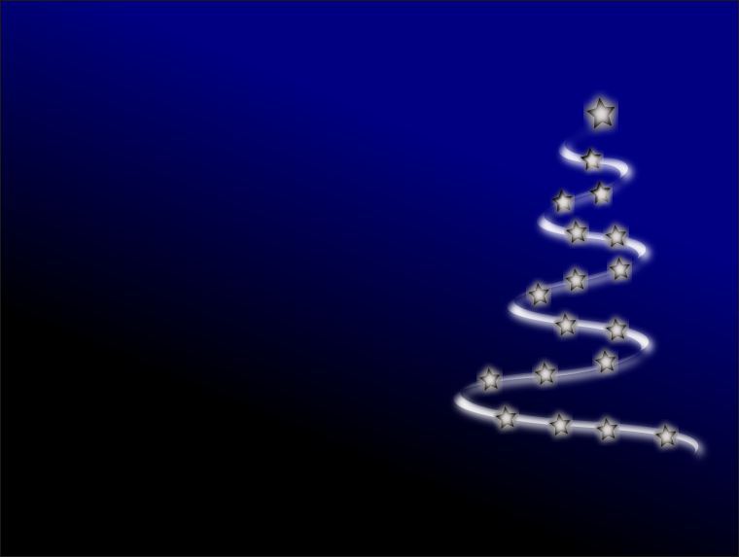
Wokingham Library Code Club
Christmas Coding Challenge 2019

Slide 2
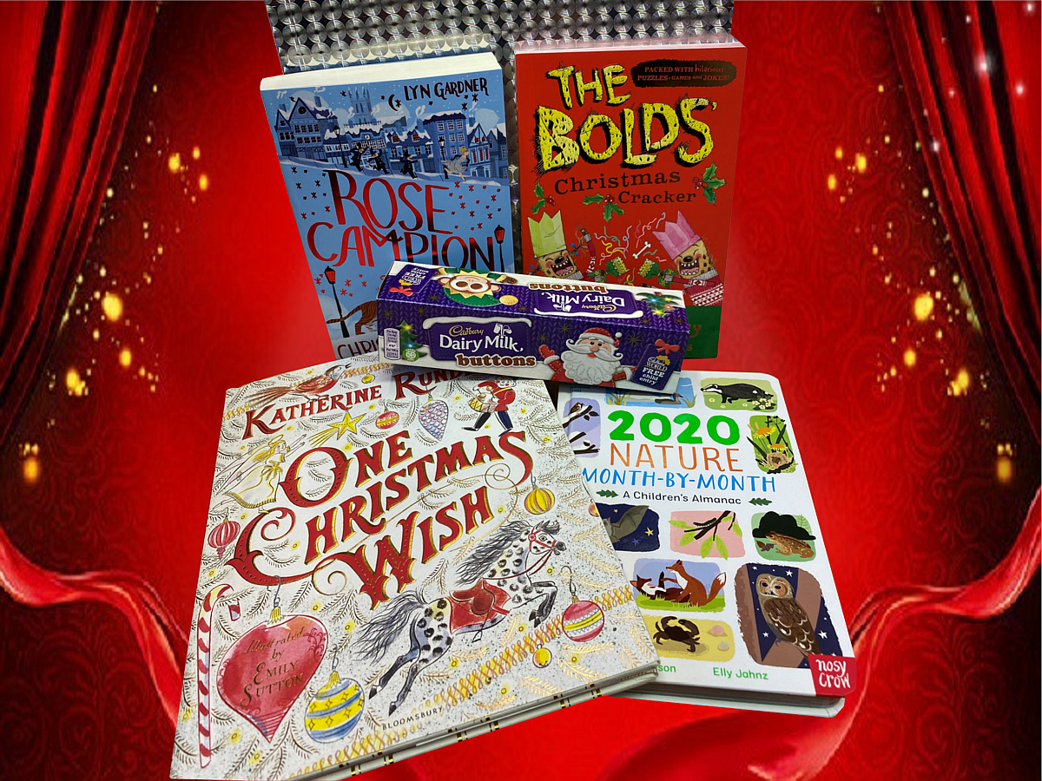
PRIZES...

Slide 3
The Challenge
Use Scratch to make an animation (up to 45 seconds long) for the festive season.

Slide 4
How to get lots of marks
Do really clever coding. This will get more marks than just making nice graphics.
Here are some things to include in your code:
Lots of Movement
If/else blocks
Repeat blocks
Variables
Random Numbers
Clones
Calculations
Messages
You can use sound as well, if you like.
Try using a Scratch block you have never used before!

Slide 5
Judging and prize-giving:
The judging will take place on Saturday 14th December, after 11.15am.
All the entries will be shown on the big screen. You can give a short introduction to your entry if you like.
All the young coders will be able to give a mark to every entry except their own.
The club organisers will be the other judges.
The prizes will be awarded at the end.

Slide 6
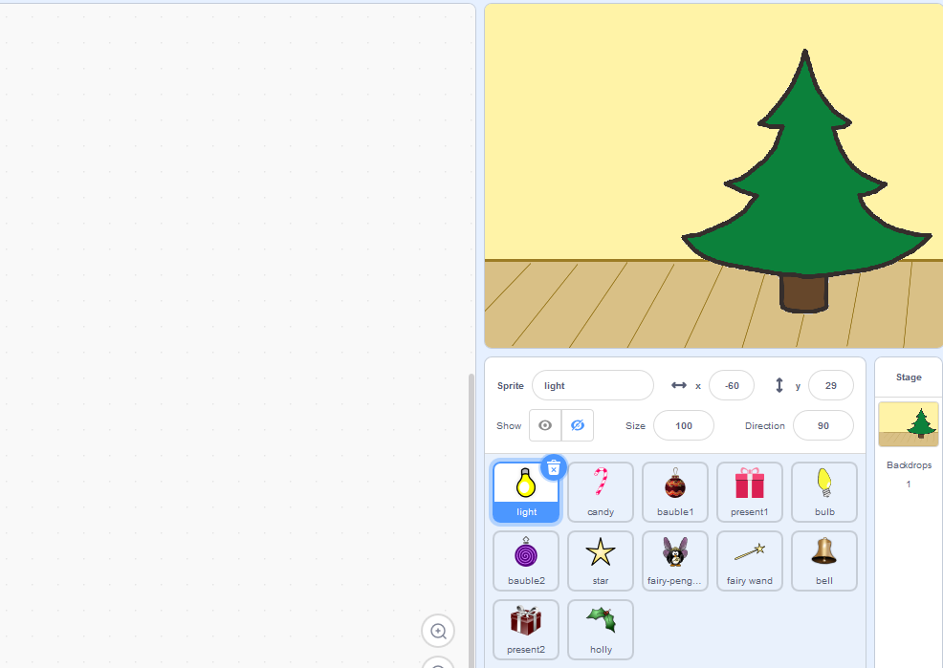
scratch.mit.edu/projects/346471686/editor/
Ideas:
decorate a Christmas tree
Go to this project page while you are logged in with your Scratch user and Remix the project to be able to work on your own version

Slide 7
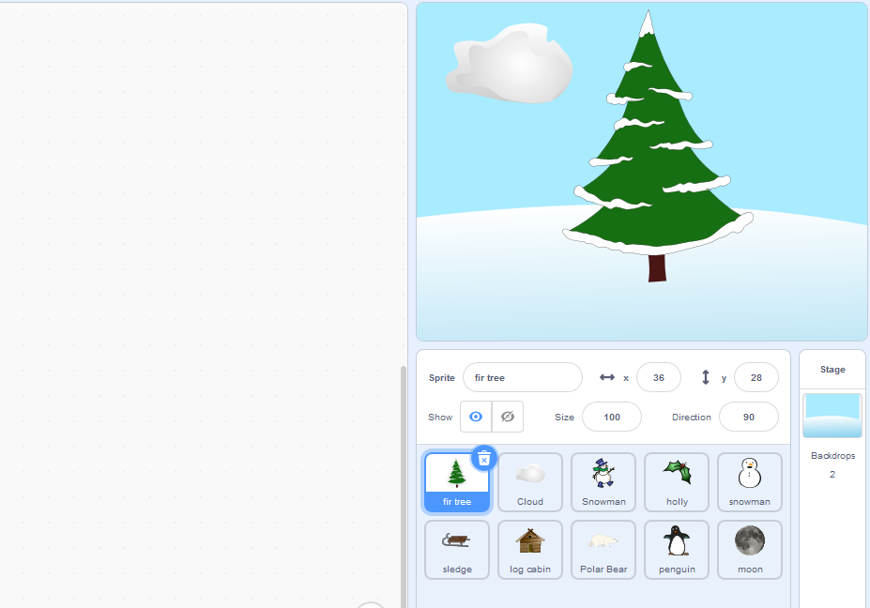
scratch.mit.edu/projects/348937468/editor/
Ideas:
animate a winter scene
Go to this project page while you are logged in with your Scratch user and Remix the project to be able to work on your own version

Slide 8
Our webpage on github:
github.com/WokLibCodeClub
Details of the Christmas Challenge are in the section called:
Christmas-Coding-Challenge-2019

